Slide 1

Forbes Top
Top 500 private sector companies in US
Data Visualization
Mohitkumar Rangholiya
Notes:
We have analyzed the data of top 500 private sector companies in us and we have derived some important interpretations for the investors and market researchers and we have represented these using some interactive ways of visualization for better and rapid understanding. These will be helpful to the investors to have justified idea of investing in best industry and the best company in that industry to have good return of investment.

Slide 2
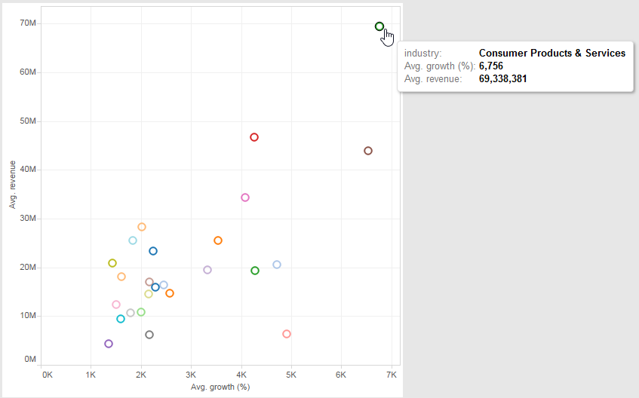
▹ Finding the best industry to invest in
The ‘Forbes Top’ provides list of the 500 fastest growing private sector companies in United States. The list is compiled by measuring each company's percentage revenue growth over a four-year period.
This summary graph shows only about revenue and growth, but does not tell the investors about other information of the companies and industries such as location, URL etc. so to be more powerful we will present this by using the dashboard.
Consumer Products & Services is the best industry to invest as it has the highest growth & revenue
Notes:
There is a seminar of investors organized in US. Job who is a market researcher and appointed to represent the optimal investment options for the investors by explaining the data of Top 500 private sector companies in US. This graph shows the best industry to invest by considering the total Growth of the companies belong to a specific industry, and Consumer Products & Services is the best and highest percent Growth. Consequently, this can be the center of investment.
However, the summary graph is missing some significant information such as location, URL, the company’s rank etc.
Next slide will provide the fully views and interactive dashboard including varies kind of charts for investor to understand and to be more easily to make a decision on investment.

Slide 3
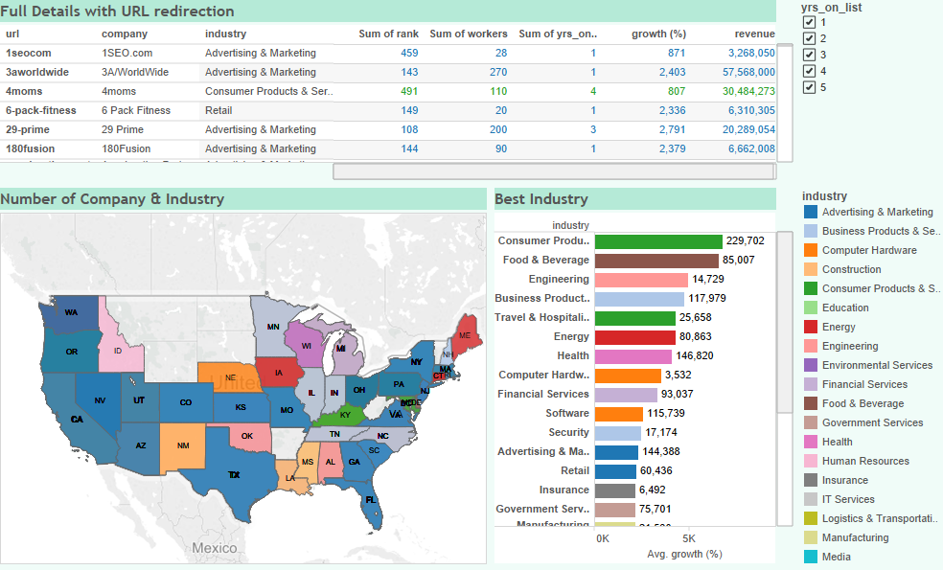
▹ Interactive Dashboard
The purpose of this interactive dashboard is to rapid and easy way to understand and decision making for investors and market researchers while investing. It allow them to select filter criteria (Year on list, colours, state of US, industries etc.) to see specific data and details.
Chart A
 | Description
A | Address of company's web page and significant information of companies, filter by Year on list.
B | Number of companies located on each state in US by the top industry and particular industry with it’s average growth & revenue
C | Top industry by average growth % and revenue of the last year
Chart B
Chart C
Notes:
This is the interactive dashboard that user especially investor can easily assess to the information.
The differences chart show different results, the following slide will explain all of them.

Slide 4
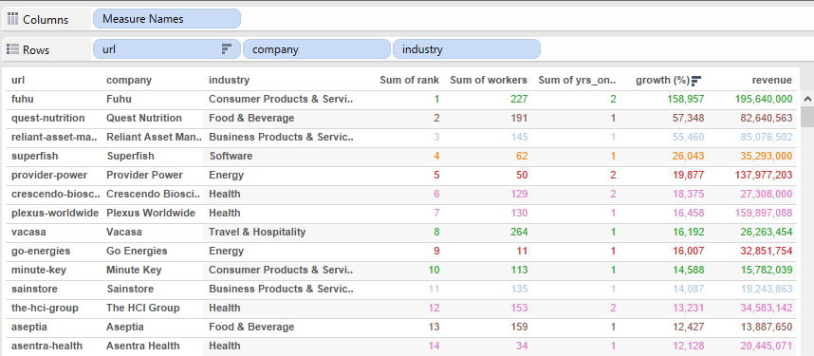
▹ URL Redirection
Chart A of the dashboard shows the URL of companies’ website and information of the companies, also showing the significant details as growth %, revenue of the last year, rank and number of workers, by hierarchy the categorical data.
The growth % shows sorting of results by highest
to lowest
URL of each company user can click on the URL, they are linked to the web page
Colour filter: Chart A used the colour filter to classify the kind of industries, the next slide will show how the colour filter work for this dashboard.
Notes:
This tabular graph shows most of important details of all the companies with it’s redirection to the company url on clicking it.

Slide 5
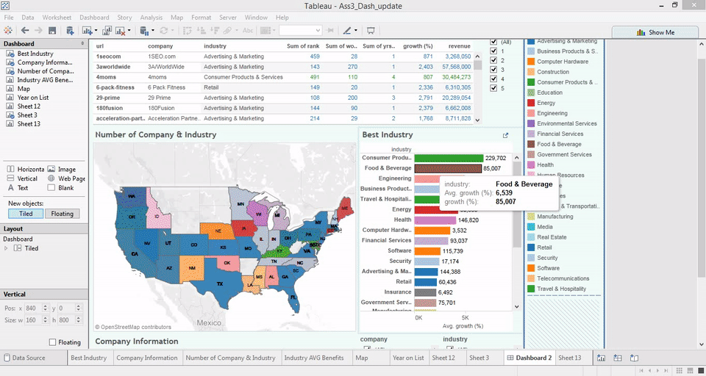
▹ URL Redirection (Cont.)
This is the sample how the dashboard work with the linked URL. When we click on the color filter the dashboard will show only that industry and when we click on the URL name it will redirect investors to the company’s web page.

Slide 6
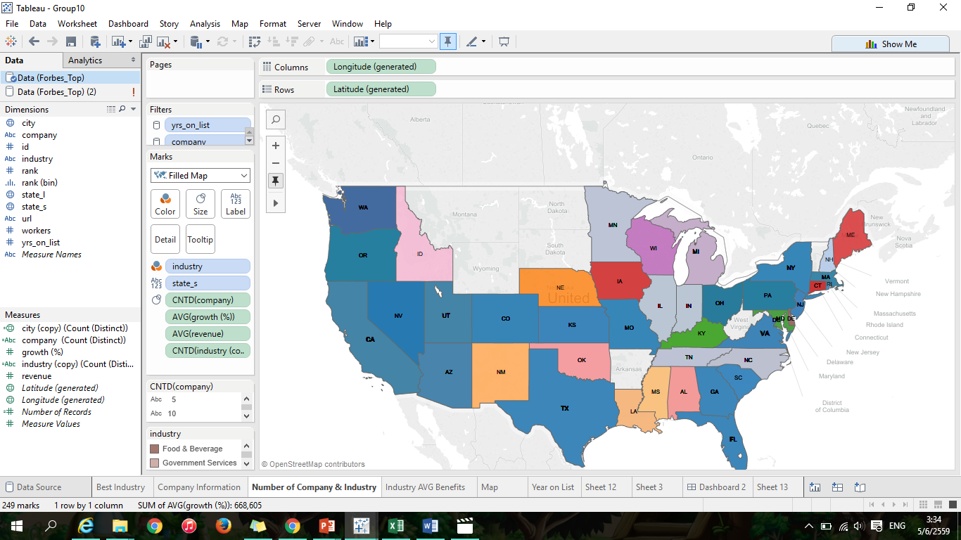
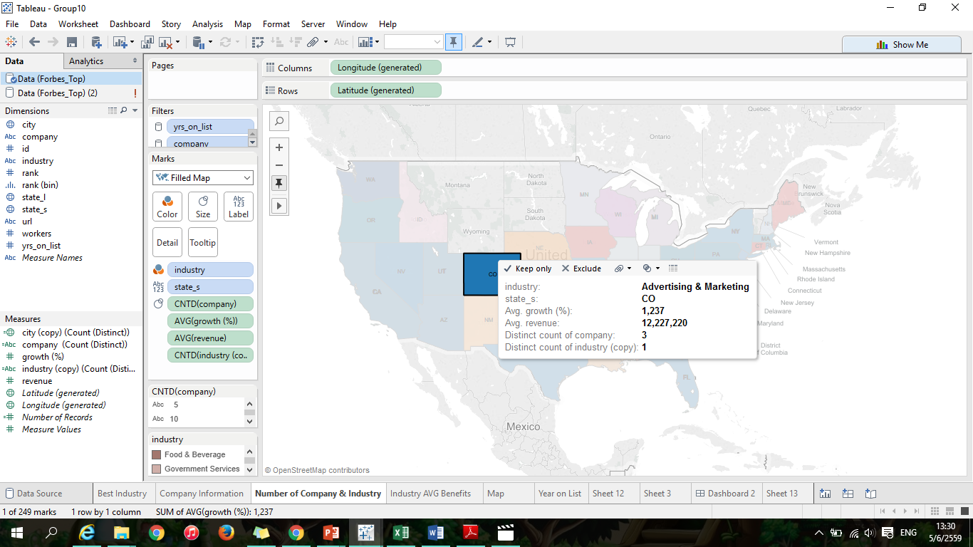
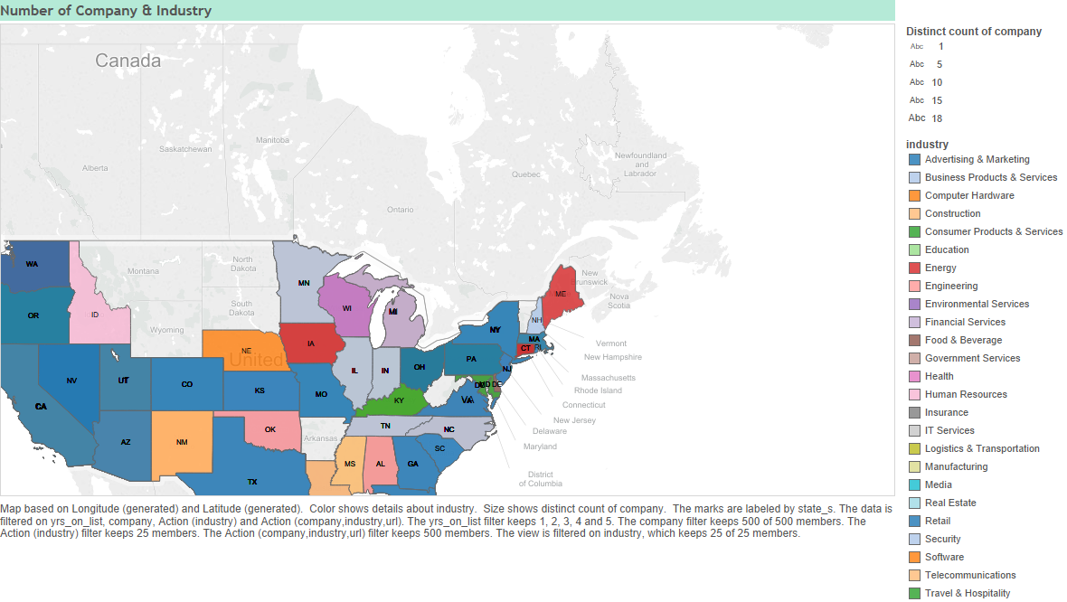
▹ Top industry located on state
Using the location which is state of each company in Chart B to identify the highest number of companies in particular industry located in each state in US showing in Picture A. Picture B demonstrates how the map work in this dashboard when click on a state in US.
By zooming to expand the map for better views
Picture A
Picture B
Notes:
This interactive map is representing state wise top industry and number of companies of that particular industry with it’s average growth & revenue on each state in US.

Slide 7
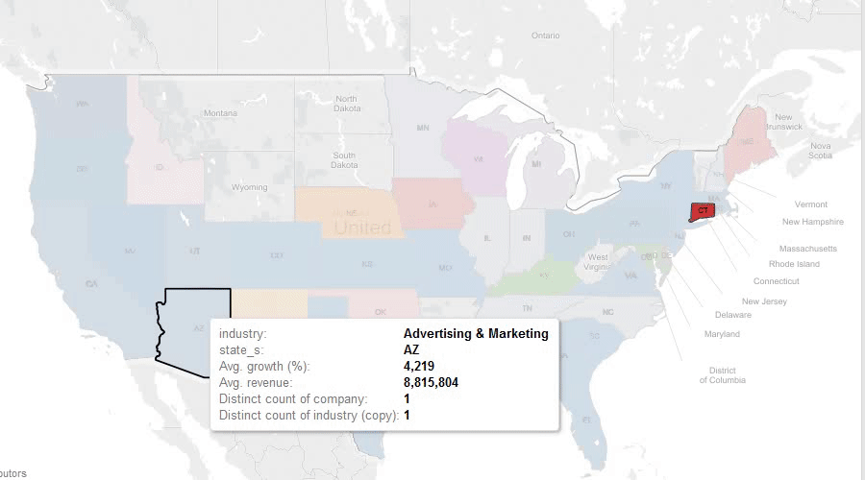
▹ Top industry located on state (Cont.)
The Graphics Interchange Forma demonstrates how the map work in this dashboard when we click on any state in US.

Slide 8
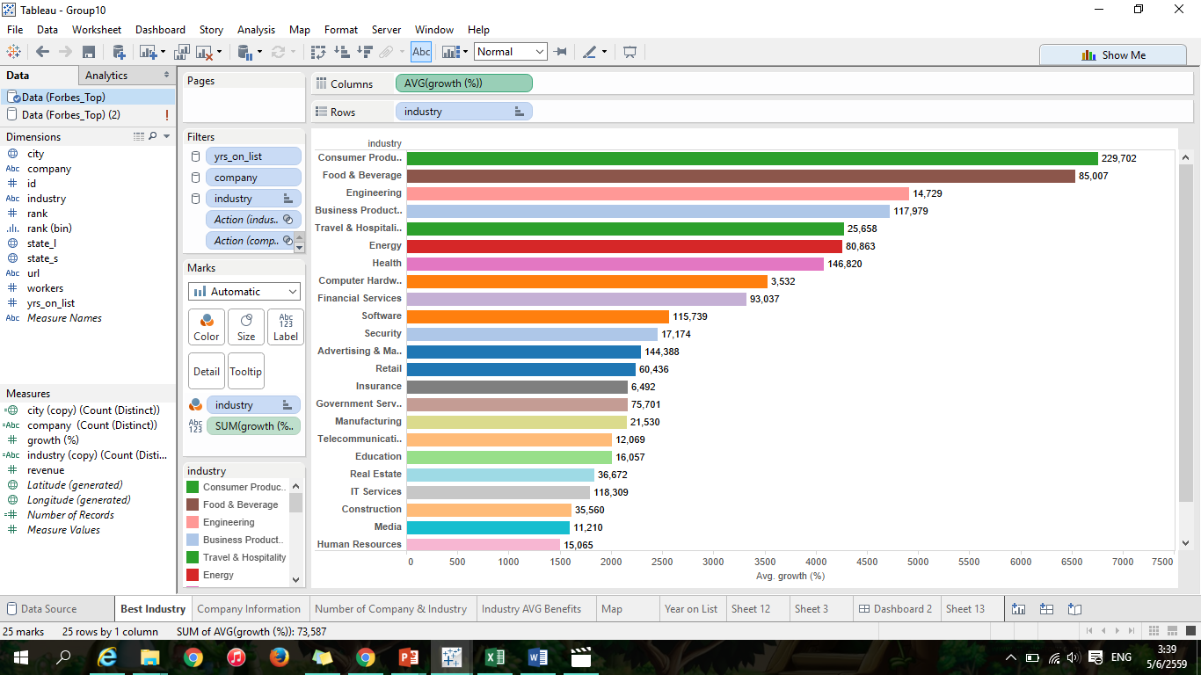
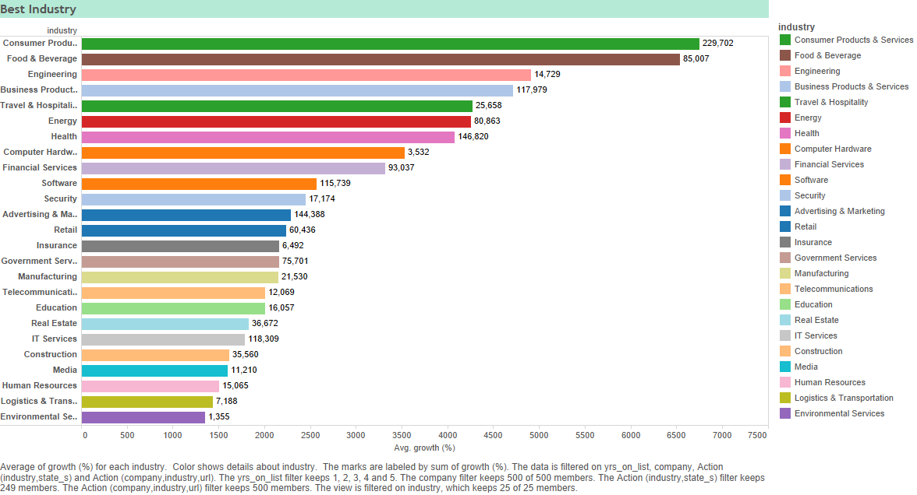
▹ Highest Growth % of industries
This interactive map is representing state wise top industry and number of companies of that particular industry with it’s average growth & revenue.
Sorting industries to show the Highest and Lowest industries’ Growth %
Labels tell the average Growth%
Colour filter linked all the dashboard

Slide 9
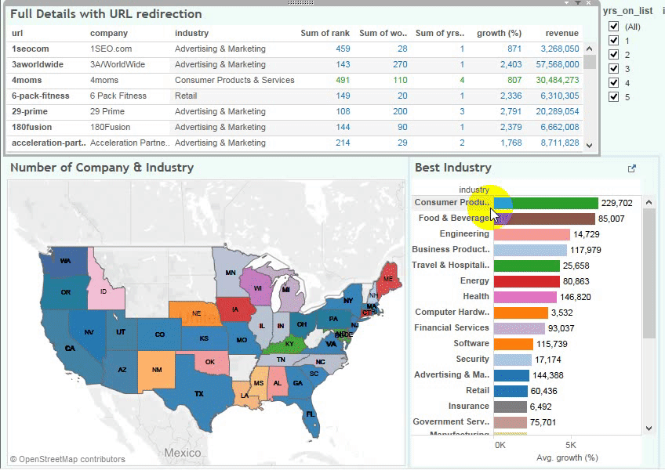
▹ Interactive Dashboard
This illustrates how the interactive dashboard work, when investors click on the filters and how all the graphs are linked together showing the information of companies.

Slide 10
▹ References
"Forbes Welcome". Forbes.com. N.p., 2016. Web. 5 June 2016.
"Arizona Latitude And Longitude Map". Mapsofworld.com. N.p., 2016. Web. 5 June 2016.

